Slide 1
Finding suitable locations to open a Gym in Athens, Greece M.Manikanta Reddy(April 2020)

Slide 2
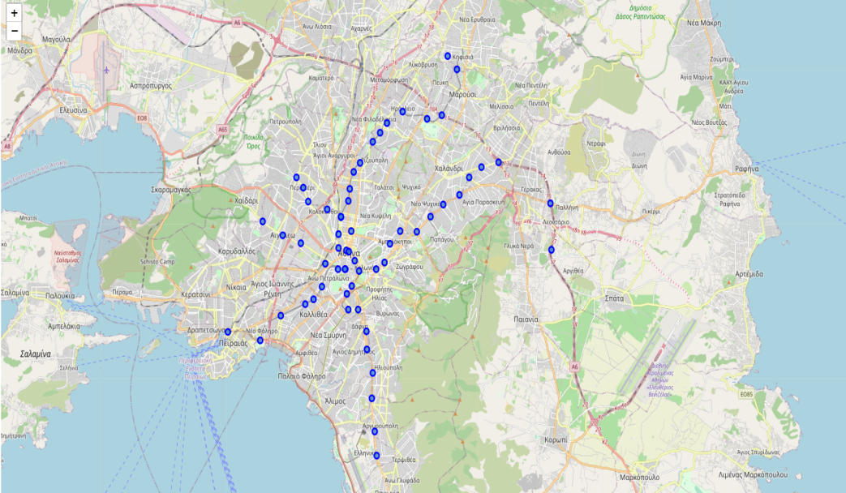
Business Problem
The gym should be located near a metro station
Things to be considered:
Number of existing gyms in the area
Distance from each station to nearest gym
Data
Starting point: Syntagma Square
Obtain its geospatial coordinates
Using Foursquare API:
Find all metro stations in a radius of 15 km from Syntagma Square
Find existing gyms in a radius of 750 m from each station
Calculate minimum distance from every station to a gym

Slide 3
Data Description, Transformation and Cleaning
64 initial metro stations found
3 stations were train depots so removed from the data set
Out of the remaining 61 metro stations 59 found with gyms in their vicinity
No data for 2 stations (either non-existent data or no stations around these stations)
Only gyms categories with description “Gym / Fitness Center” and “Gym” were considered.
All other categories (Dance Studio’, ‘Yoga Studio’, ‘Martial Arts Dojo’ etc.) were excluded
Data were normalized for the final calculations

Slide 4
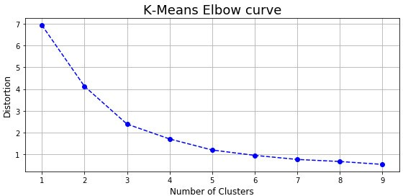
Methodoloy
Machine Learning (K-Means clustering algorithm) was used to create clusters of stations
3 numbers of clusters were calculated based on the algorithm recommendation (elbow method)

Slide 5
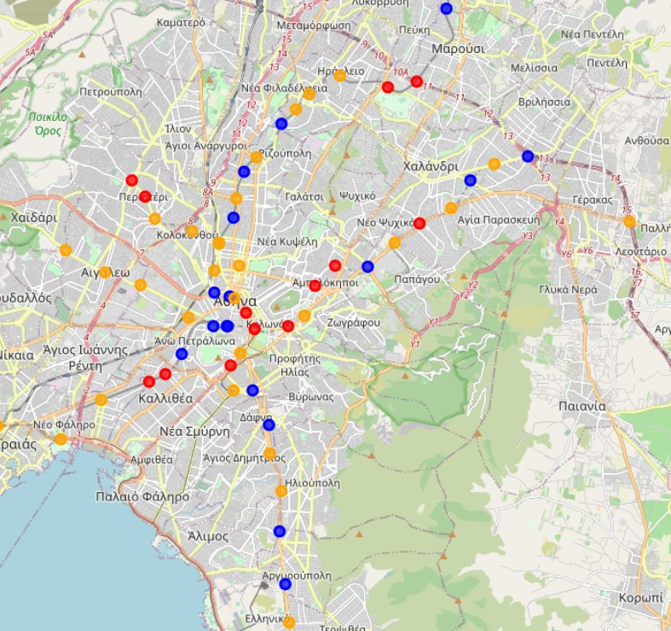
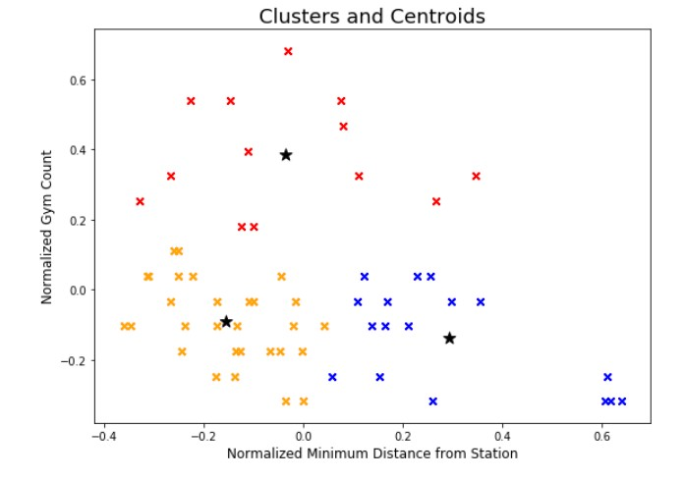
Results 1
Metro Stations Cluster Map
Metro Stations Clusters Distribution

Slide 6
Results- 2
Cluster 1 – LOW potential (Red on the map)
There are already many existing gyms in the area and the nearest gym is in most cases in a relatively short distance from the station. stations
Cluster 2 - AVERAGE potential (Orange on the map)
Although not a prohibitive metro station to open a gym in its vicinity, there is already a fair number of gyms in the area and the nearest one is not far from the metro station.
Cluster 3 - HIGH potential (Blue on the map)
There are not many already existing gyms in the area and the nearest gym is in most cases relatively not in a short distance to the metro station.

Slide 7
Discussion-Conclusion
Possible areas that were not in the Foursquare database should also be examined so that it can be determined if it is just lack of data about these stations or indeed there are no gyms in the vicinity of the stations.
A lot more factors can be considered when choosing an appropriate location. Some examples of extra factors can be:
Population density in the area
Number of businesses operating in the area (people may want to go to a gym close to work)
Average age and household income in the area
Property prices in the area
The above results can be a good starting point for a prospective businessman that is interested in opening a gym. Similar methodology can be used for other types of businesses probably with customized criteria.

